Slide 1
Introduction to Behavioural Economics
By Charlotte

Slide 2
What is Economics?
Economics is the social science that studies how people interact with value; in particular, the production, distribution, and consumption of goods and services.
→ About choice!
Notes:
We focus on decision making.

Slide 3
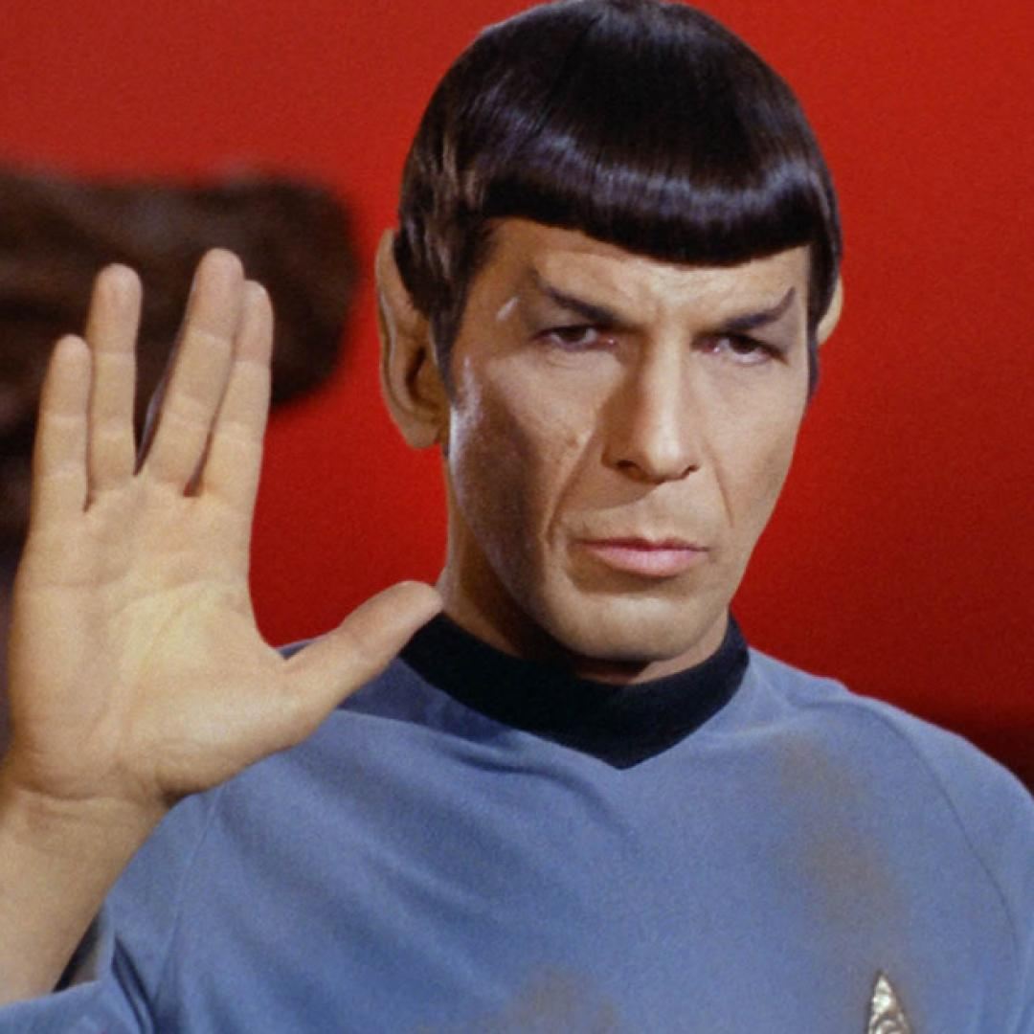
Homo Economicus
→ Optimisers!
Know what's best
Stable preferences
Unbiased beliefs
Self-interest
Notes:
Bref, they are RATIONAL
isn't economics about people behaviour intrinsically? well not anymore

Slide 4
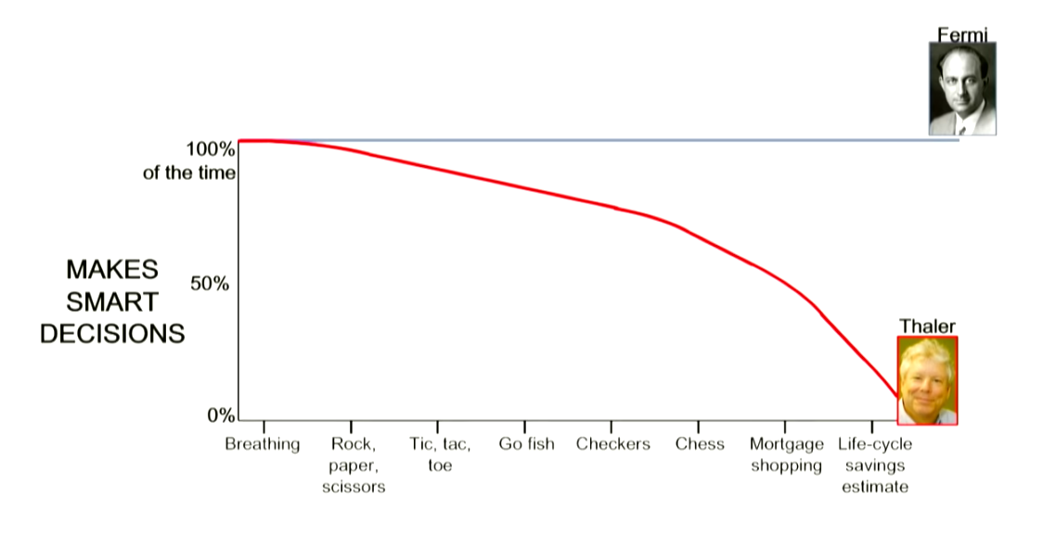
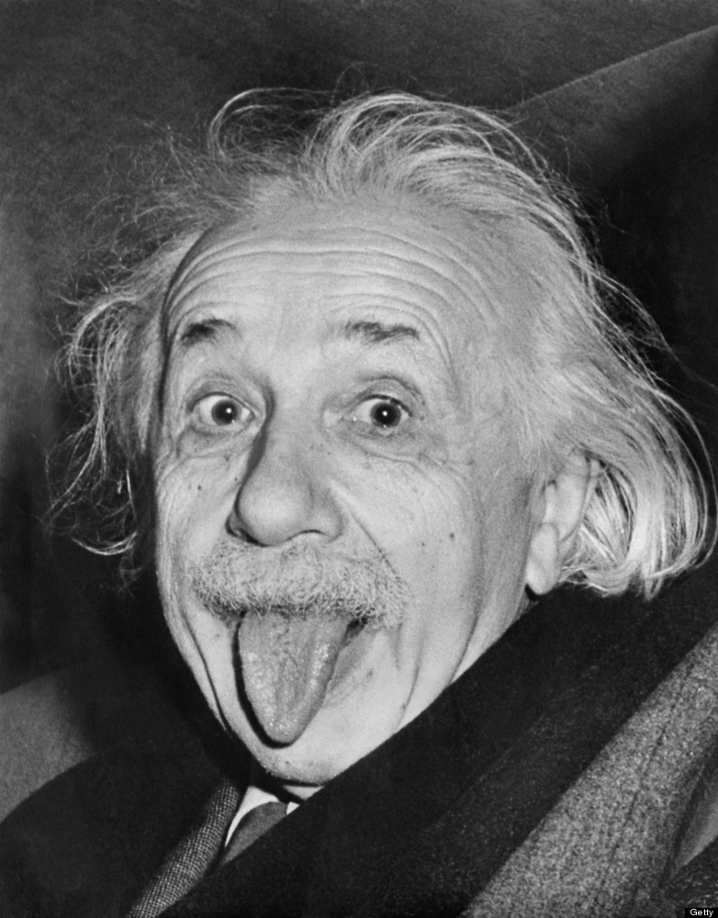
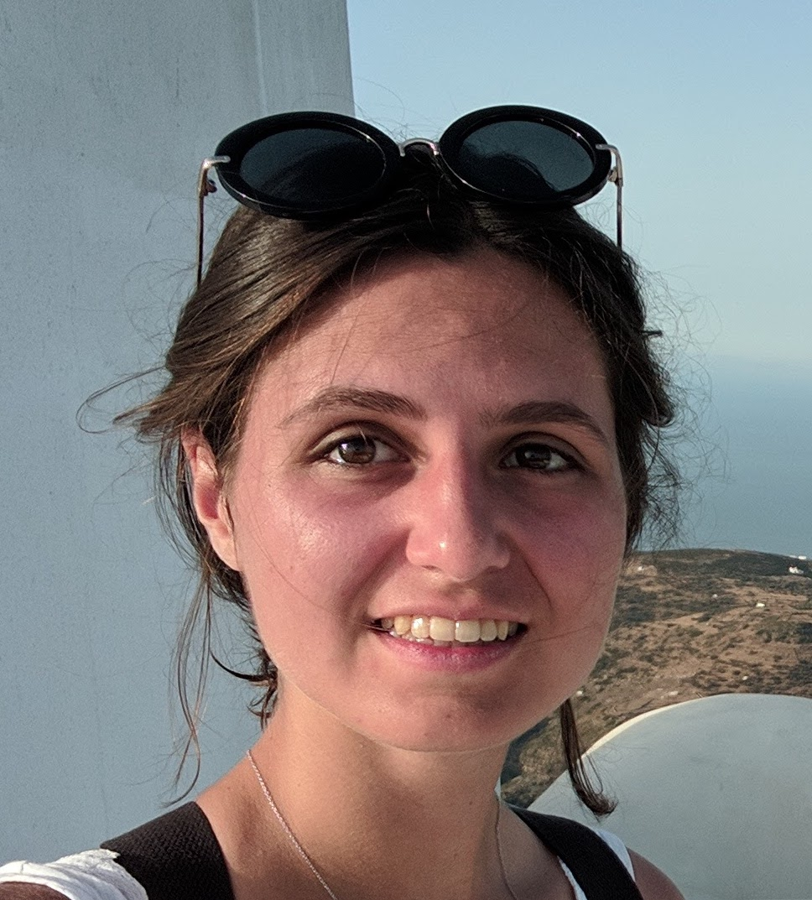
Bounded Rationality
Herbert Simon
Cognitive constraints
Time constraints
Optimizing vs. Satisficing
Notes:
We might not be, in real life, able to be rational.
Economist chose to ignore “irrational”’ behaviour as is unpredictable and random, so hard to predict and thus we can ignore it - chose the road of predictability and mathematical optimisation.
If prices fall, we buy more. All good. But if price is really low, the people might fear it’s poor quality and buy less. Breaking the law of demand.
Economist so how do we behave better? more and better info - just teach people yet, we know full well what we should do, we just don't

Slide 5
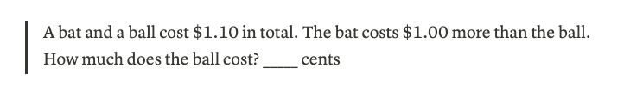
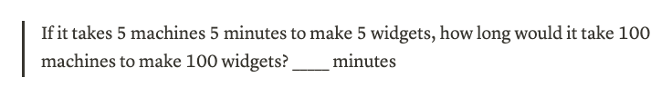
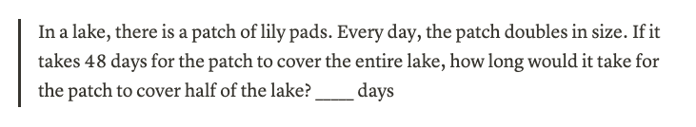
Notes:
Exmaples of our bounds

Slide 6
1. Knows what’s best

Slide 7
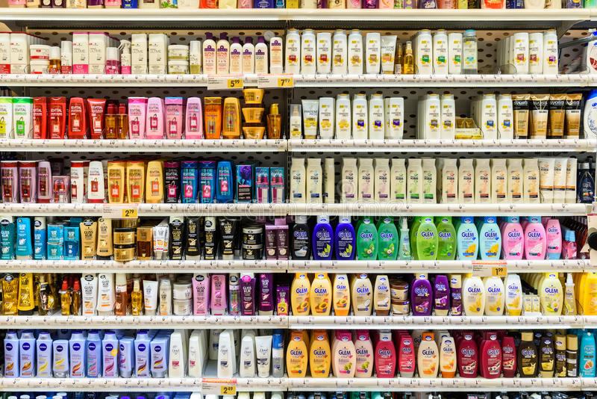
Choice overload
Notes:
Btw that’s why advertising works so well, you go for the familiar stuff
Phone example

Slide 8
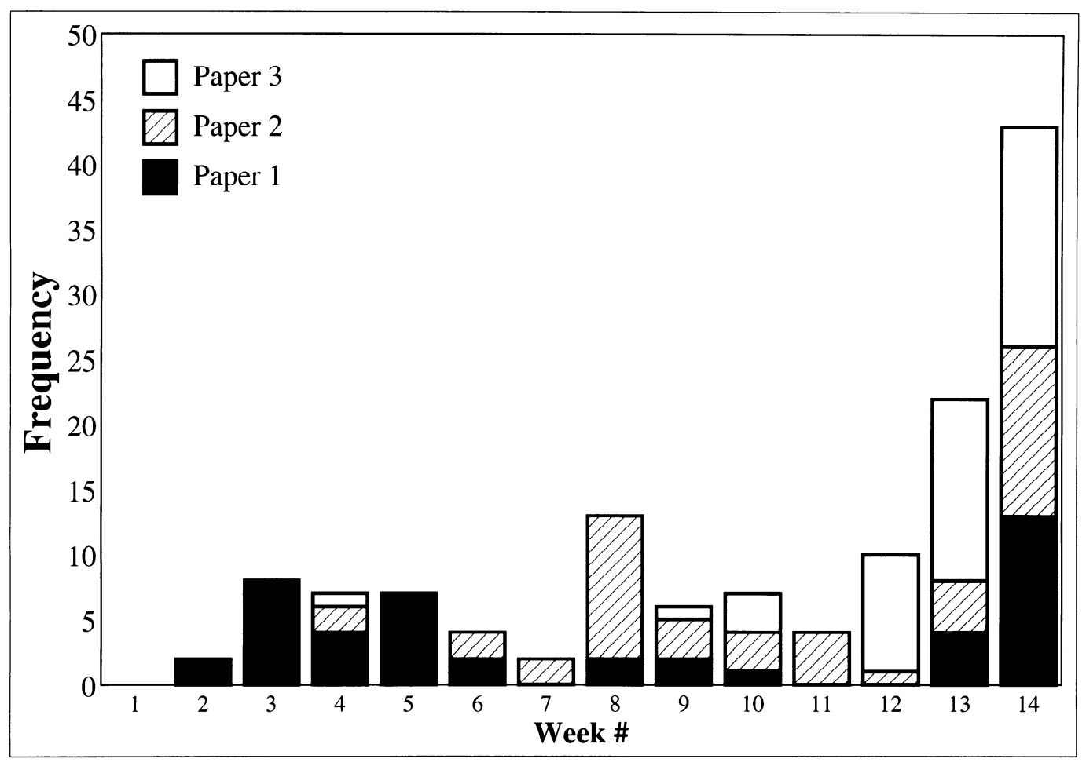
Procrastination
Not optimal
If we know best then we don’t need to pre-commit
Notes:
More is better!

Slide 9
Hyperbolic discounting
50€ now or 100€ in 1 year?
50€ in 5 years or 100€ in 6 years?

Slide 10
2. Stable preferences

Slide 11
The Allais paradox
Gamble 1
1 million € for sure
89% chance of 1 million 10% chance of 5 million 1% chance of nothing
Gamble 2
89% chance of nothing 11% chance of 1 million
90% chance of nothing 10% chance of 5 million

Slide 12
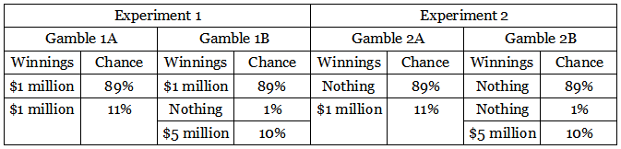
The Allais paradox
Notes:
Huge violation of the axioms. Something is wrong

Slide 13
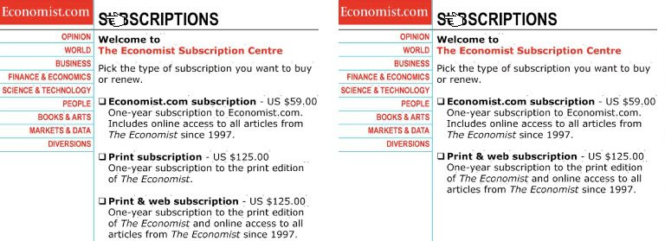
Decoy effect

Slide 14
Loss aversion
Gamble 1:
50% chance of 100€ 50% chance of 0€
100% chance of 50€
Gamble 2:
50% chance of 0€ 50% chance of -100€
100% chance of -50€

Slide 15
3. Unbiased beliefs

Slide 16
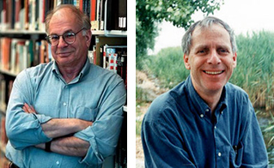
Decision-making in Psychology
David Kahneman & Amos Tversky
our irrationality is very context dependent, it's not random, it's a predictable, systematic error in our judgment
Notes:
Turns out that quite independently, two psychologist had started systematically studying and documenting people’s irrationality. Economist had no idea about them until Thaler “discovered” them.
200+ papers
their insight is that people make errors, but mostly that these errors are predictable!
means people deviate from economic theory in a predictable way.

Slide 17
Heuristics and Biases
Availibility bias
Anchoring bias
Conjunction fallacy
Gambler’s fallacy

Slide 18
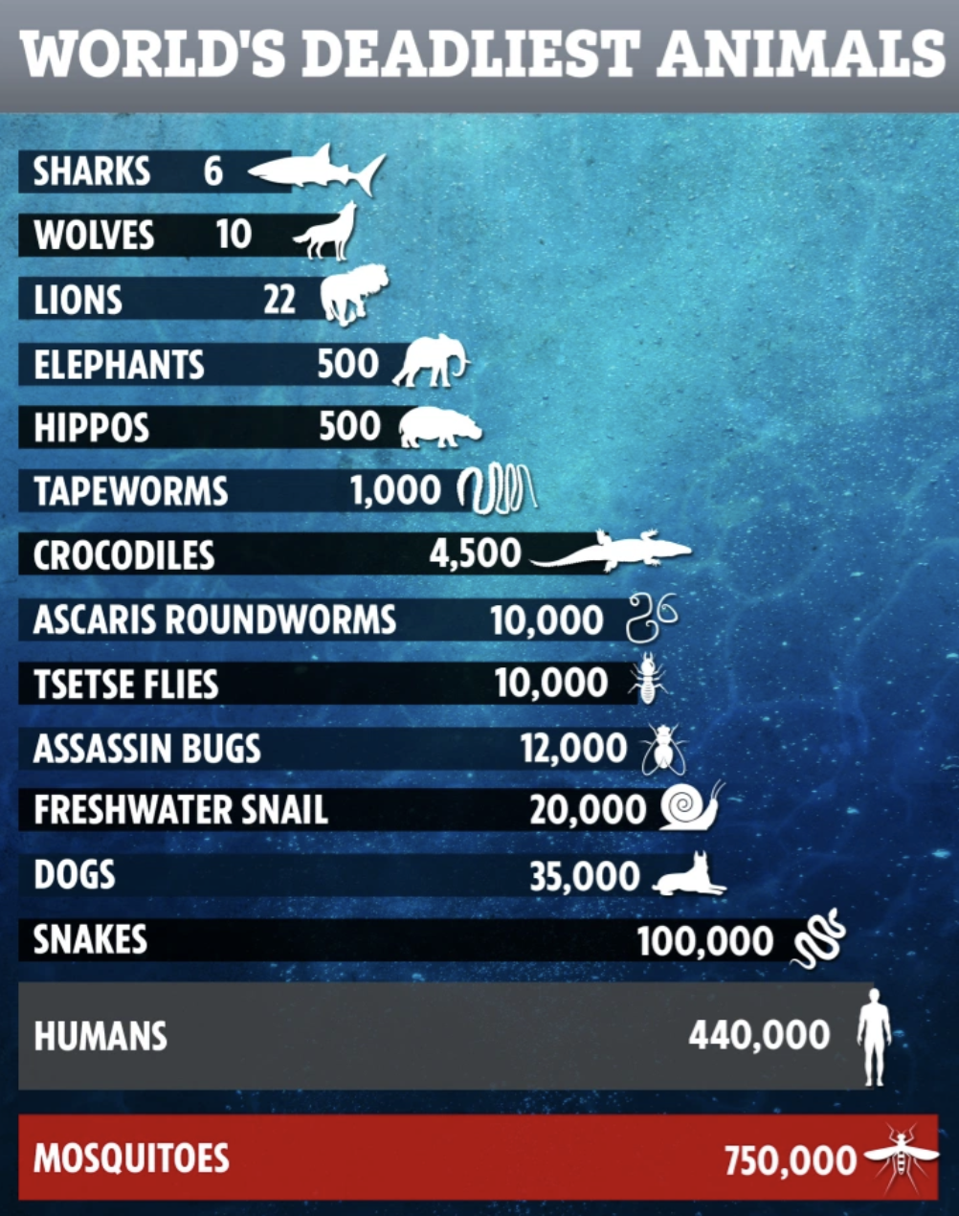
Heuristics and Biases
Availibility bias
Notes:
I highly recommend this book, it’s full of examples of how irrational we are.
People either choose the mathematically wrong answer, or they contradict themselves

Slide 19
Heuristics and Biases
Anchoring bias
1 x 2 x 3 x 4 x 5 x 6 x 7 x 8 x 9
9 x 8 x 7 x 6 x 5 x 4 x 3 x 2 x 1
Notes:
Judge sentences
Negociations
Donations

Slide 20
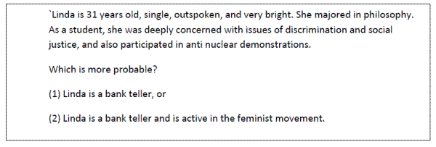
Heuristics and Biases
Conjunction fallacy
Notes:
I highly recommend this book, it’s full of examples of how irrational we are.
People either choose the mathematically wrong answer, or they contradict themselves

Slide 21
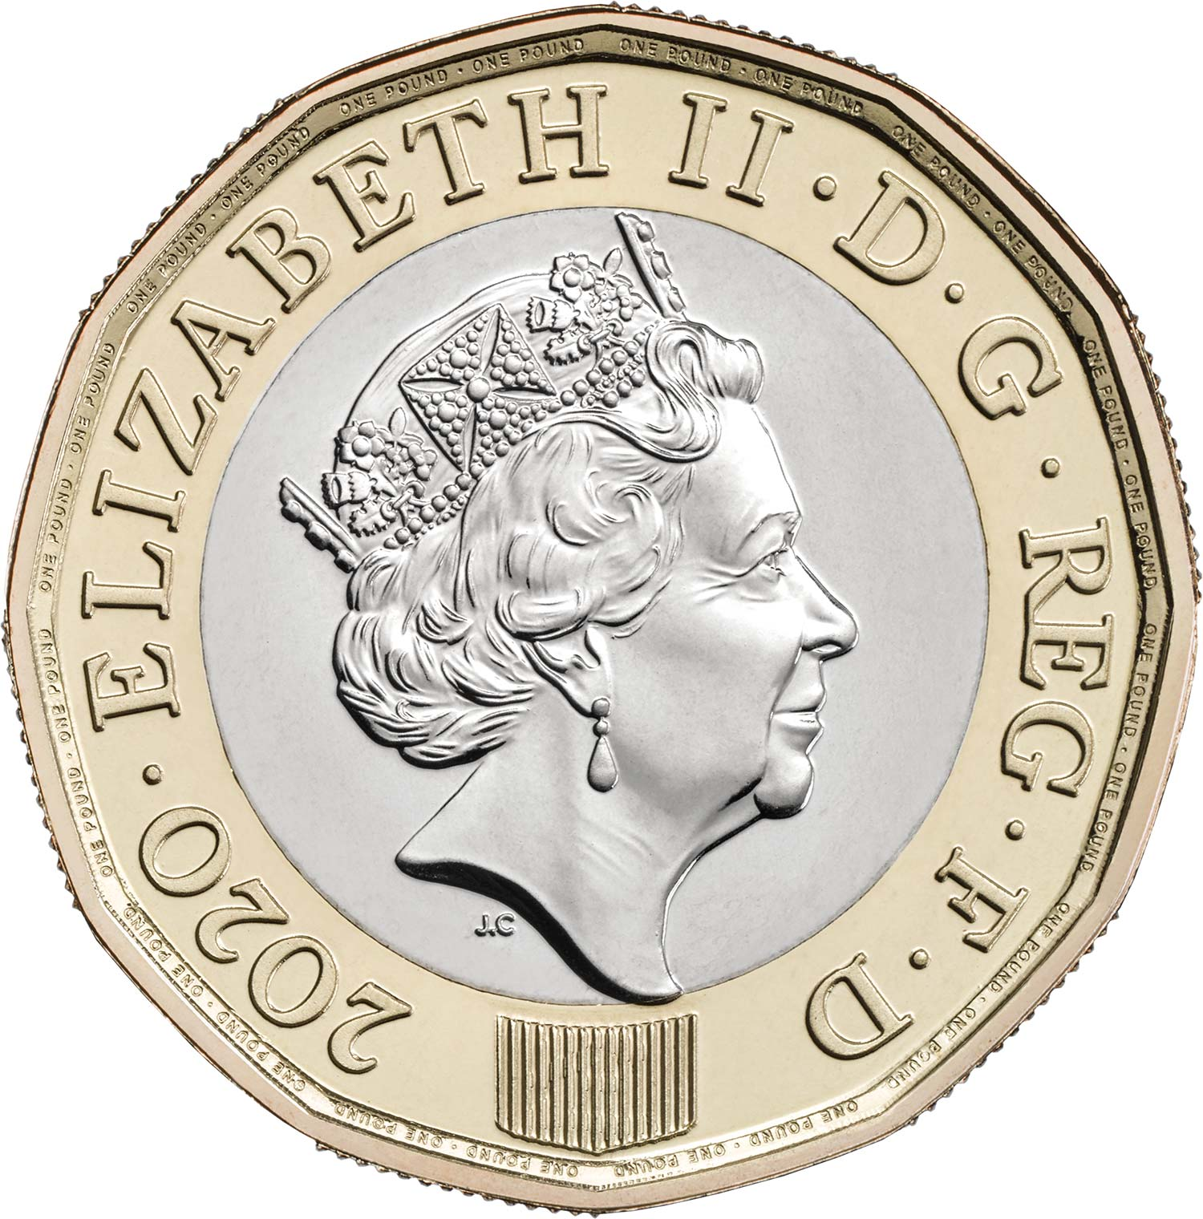
Heuristics and Biases
Gambler’s fallacy
?
Notes:
I highly recommend this book, it’s full of examples of how irrational we are.
People either choose the mathematically wrong answer, or they contradict themselves

Slide 22
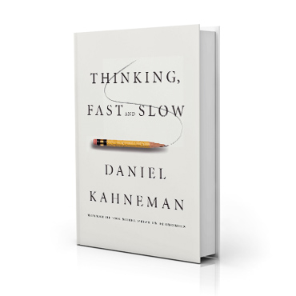
Heuristics and Biases
Availibility bias
Anchoring bias
Conjunction fallacy
Gambler’s fallacy
Notes:
I highly recommend this book, it’s full of examples of how irrational we are.
People either choose the mathematically wrong answer, or they contradict themselves

Slide 23
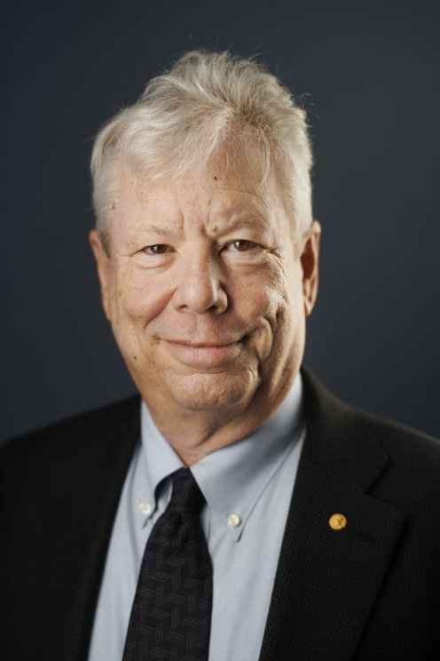
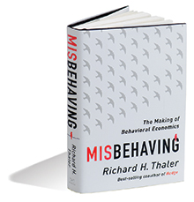
The start of a revolution
Richard Thaler
Time discounting & self-control
Endowment effect
Mental accounting
Sunk costs
SIFs
Notes:
SIF (supposedly irrelevant factors) - according to classical those are variables that should not matter at all.
framing!
WTB WTP
My socks example
Concorde & subscriptions
subfields:
behavioural GT
behavioural finance

Slide 24
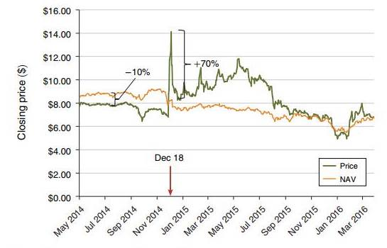
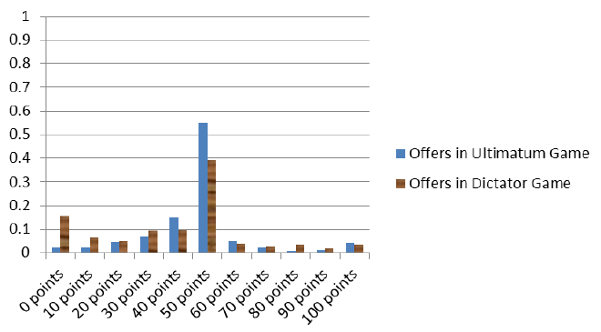
Subfields
Behavioural Finance
Behavioural Game Theory
Notes:
Asset prices reflect all available info thus you cannot beat the market and bubbles are not possible – untestable thoery!
CUBA is a closed-end fund, and closed end-fund typically trade at a discount CUBA is mostly US assets and some Mexican, nothing cuba, it’s illegal!
NAV is the net asset value so the value of the asset the fund owns
The green is the price in the fund
As I said we can see there is a discount but then all of a sudden it increases 70%...
What happened? It’s the day Obama said he was gonna relax restrictions on CUBA!

Slide 25
The Future of Behavioural Economics
No real theory, just modifications of rational theory
Models of decision-making not economic theory
Economists don't like experiments
Two theories Normative vs Descriptive
Evidence-based
Experimental Economics
Notes:
one for what we should do, the other for what people do. then maybe we can bring people closer to rational decisions
- applicable to specific problems and not general economic behaviour
economics is not necessarily becoming more behavioural, but certainly more empirical. we have more data than ever! RCTs!
Rise of experimental economics – new data
need for more evidence based – less theory

Slide 26
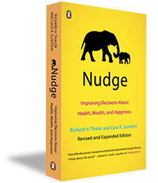
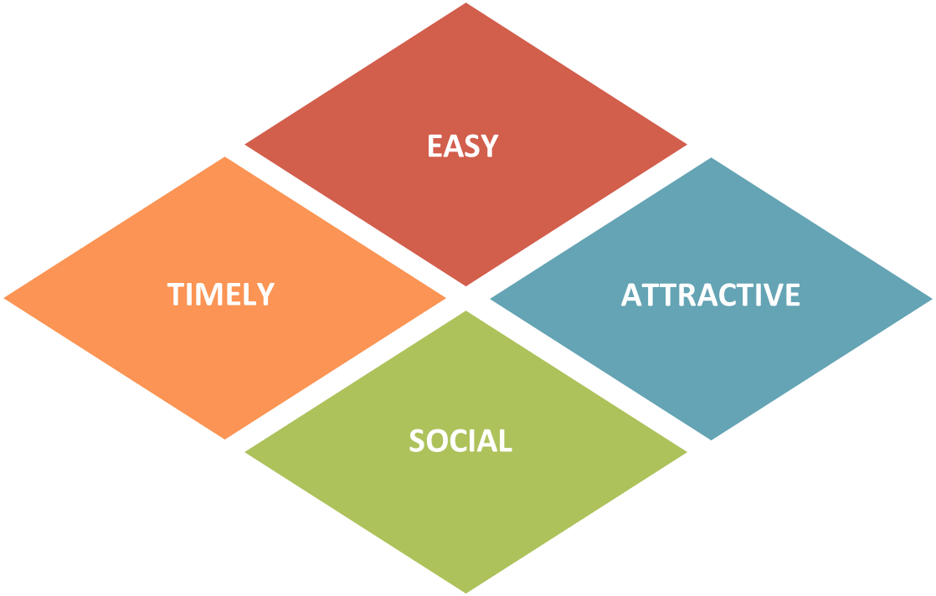
Behavioural Science
Nudging
Notes:
Make it Simple (use defaults, reduce hassle, simplify messages)
Make it Attractive (attract attention, offer incentives)
Make it Social (show that most people perform the desired behaviour, use networks)
Make it Timely (prompt people when they are likely to be most receptive)

Slide 27
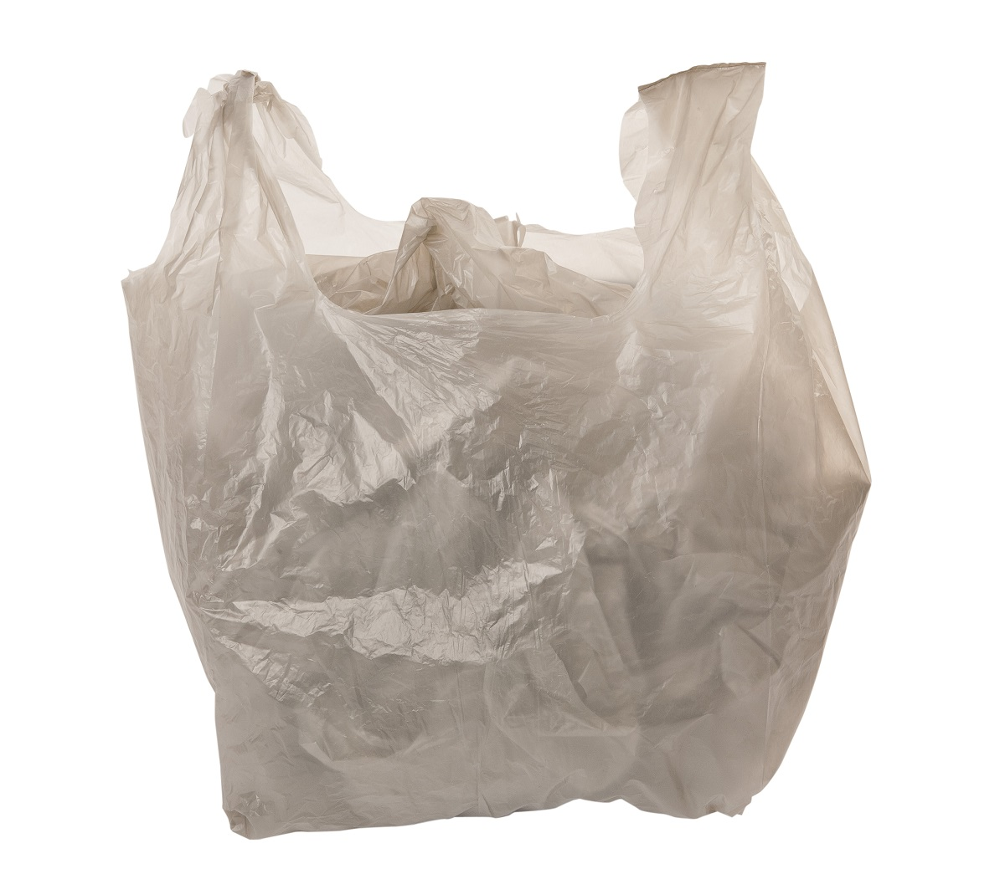
Notes:
People are loss averse

Slide 28
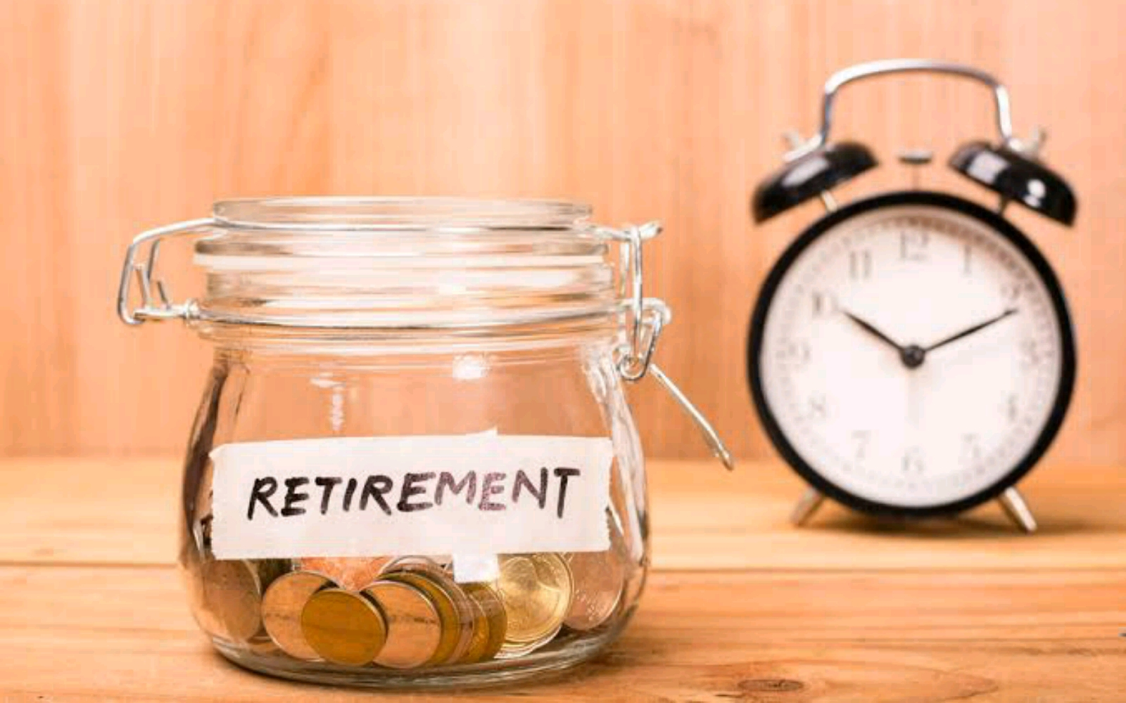
Notes:
People are lazy – make it default
People are present biased – save more tomorrow

Slide 29
Thank you!
Notes:
Most of our choices are not the result of careful deliberation. We are influenced by readily available information in memory, automatically generated affect, and salient information in the environment. We also live in the moment, in that we tend to resist change, are poor predictors of future behavior, subject to distorted memory, and affected by physiological and emotional states. Finally, we are social animals with social preferences, such as those expressed in trust, reciprocity and fairness; we are susceptible to social norms and a need for self-consistency.

Slide 30
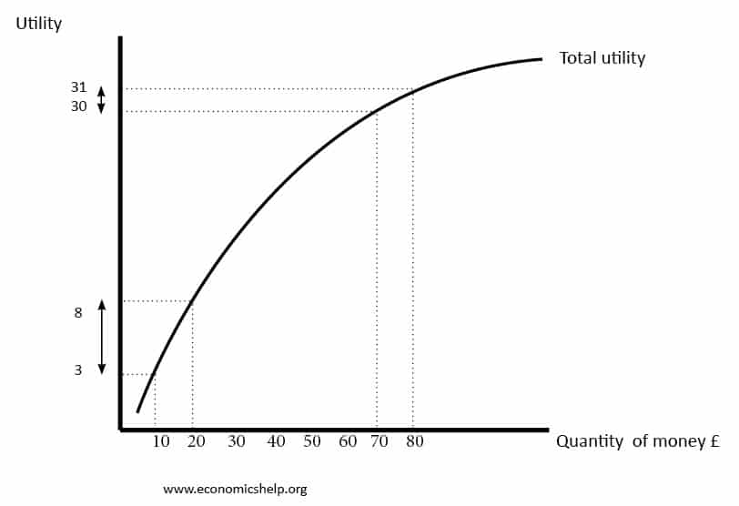
Expected Utility Theory
Risk aversion
Preferences
Completeness
Transitivity
Independence
Continuity
Reflexivity
Notes:
A theory of decision under uncertainty
Assumes we are all utility maximisers – von neuman and morgensten!
Diminishing marginal utility – risk aversion
Completeness: an individual has well defined preferences and can always decide between any two alternatives.
Transitivity: as an individual decides according to the completeness axiom, the individual also decides consistently.
Independence: two gambles mixed with an irrelevant third one will maintain the same order of preference as when the two are presented independently of the third one
Continuity:

Slide 31
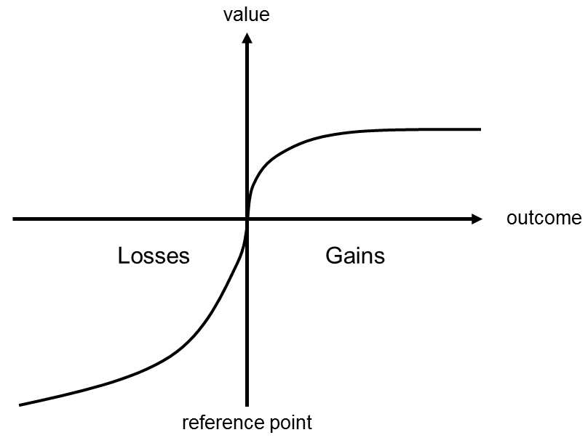
Prospect Theory
Reduced sensibility
Reference dependence
Loss aversion

Slide 32
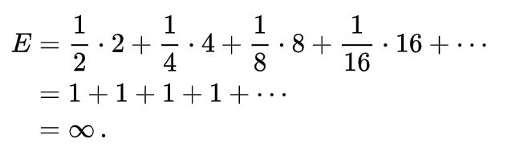

Expected Value
If tail on the first toss, E = 1/2 * 2
If tail on the second toss, E = 1/2 * 2 + 1/4 * 4
Etc…
You should be willing to pay a very very large amount!!

Slide 33
St Petersbourg Paradox
A casino offers a game of chance. A coin is tossed and each time it lands on heads, you win 2€. As soon as it lands a tail, the game ends and you pocket the money earned so far.
How much would you pay to play this game?

